Slide 1



The Making Of My Web Application Programming Project
By: Jeremy Whitenect

Slide 2
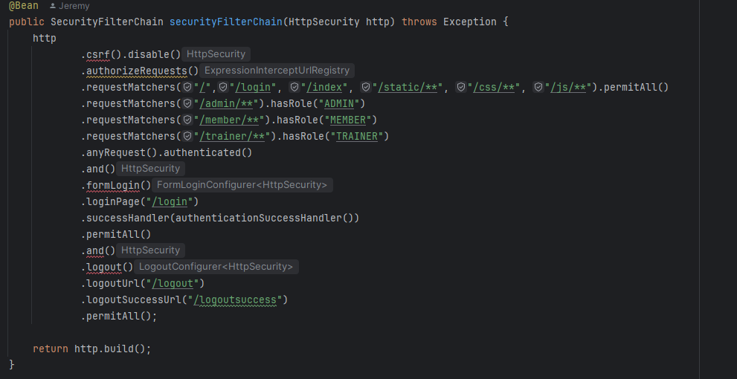
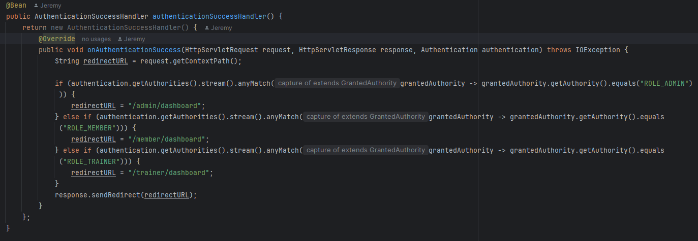
Different Levels of Access
To determine which should users should have access to which pages is surprisingly simple.
I just had to use extra request matchers in the security so that, for example, as long as a user has the “ROLE_ADMIN” role (which is a string in the user entity), they can access everything that starts with the “admin/” path.
The second screenshot is logic to send a user to their respective main page depending on their role.
There’s a default success page so that’s where a user goes if they don’t have one of the three roles for whatever reason.

Slide 3
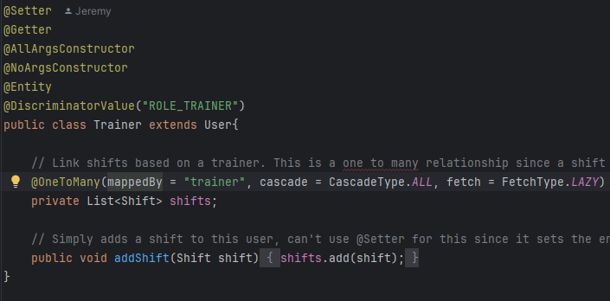
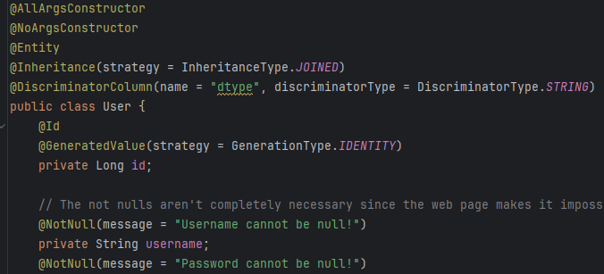
Users and Inheritance in a DB
To make it so only certain users could have certain attributes while all still being users, I knew inheritance would be needed.
To do this, I use @Inheritance with type joined so that anything that inherits a user is its own table with an id that links to the user table.
@DiscriminatorColumn is how you can tell a set of data belongs to an inherited table within the main table, and @DiscriminatorValue is what that value is.
As you can see with this example, doing things this way means that a Trainer is still a User with all those attributes but still can have aspects unique to it, like it’s list of shifts.

Slide 4
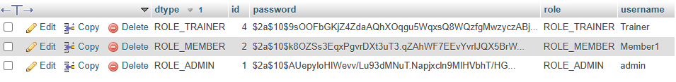
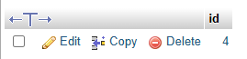

What it Looks Like in the DB
User Table
Trainer Table
Shift Table

Slide 5
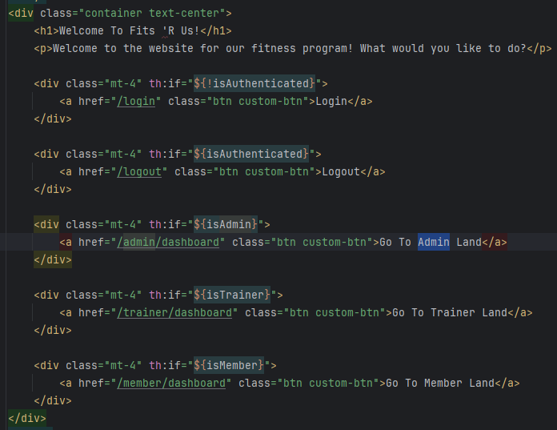
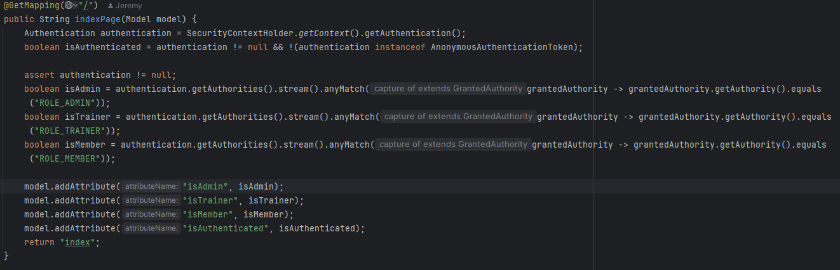
How Models Can Be Used
This is just one of a few examples in my code.
On my main page, there are login and logout buttons, as well as a button for each role’s main page.
Using thymeleaf and a model, I’ve created a variable to check for each role as well as being logged in.
This way, I can hide the buttons for login/logout based on the login state and hide the role page buttons based on the current role of the user.
I’ve used models many places elsewhere, with notable examples including posting with thymeleaf and using them to list all members, trainers, etc.

Slide 6
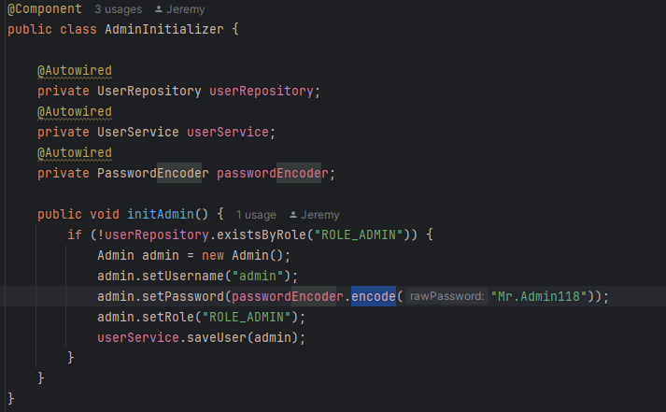
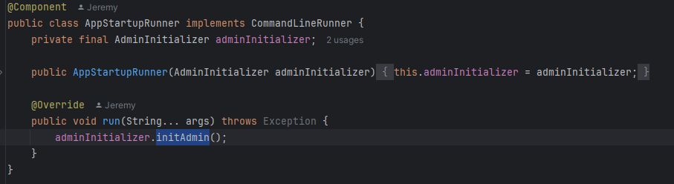
Making It So There’s Always An Admin
Admins are what make this work, being able to create other accounts and change aspects of them.
As a result, an admin should always be in the database without manually having to add one at the db level.
To do this, I first made a util class with a method that just makes an admin.
Then, I made another class being “AppStartupRunner” which extends CommandLineRunner, meaning that this runs when app is started.
Then, after initializing the AdminInitializer, all I had to do was override the run method and run the initAdmin method inside of it.
Now, whenever there is not an admin in the db, this one will be made.

Slide 7

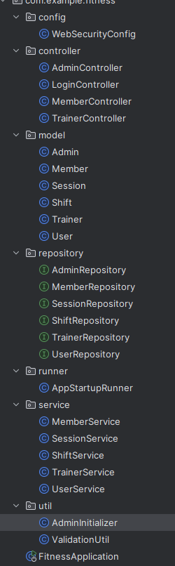
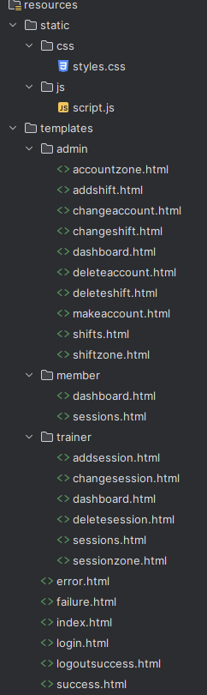
Other Things
Obviously, there’s a lot of other stuff that went into this project (as can be seen here).
I just wanted to show the most interesting parts, as well as the parts that would likely differ from my classmates’ projects.
Now is the time to ask if there’s any specific code you want to see before I run the web app to show the website side.

